Slide 1

The Drive By Project
Software Manager: Dirk Thieme
Hardware Manager: Erik Manis
Project Controller: Mohammed Ansari

Slide 2
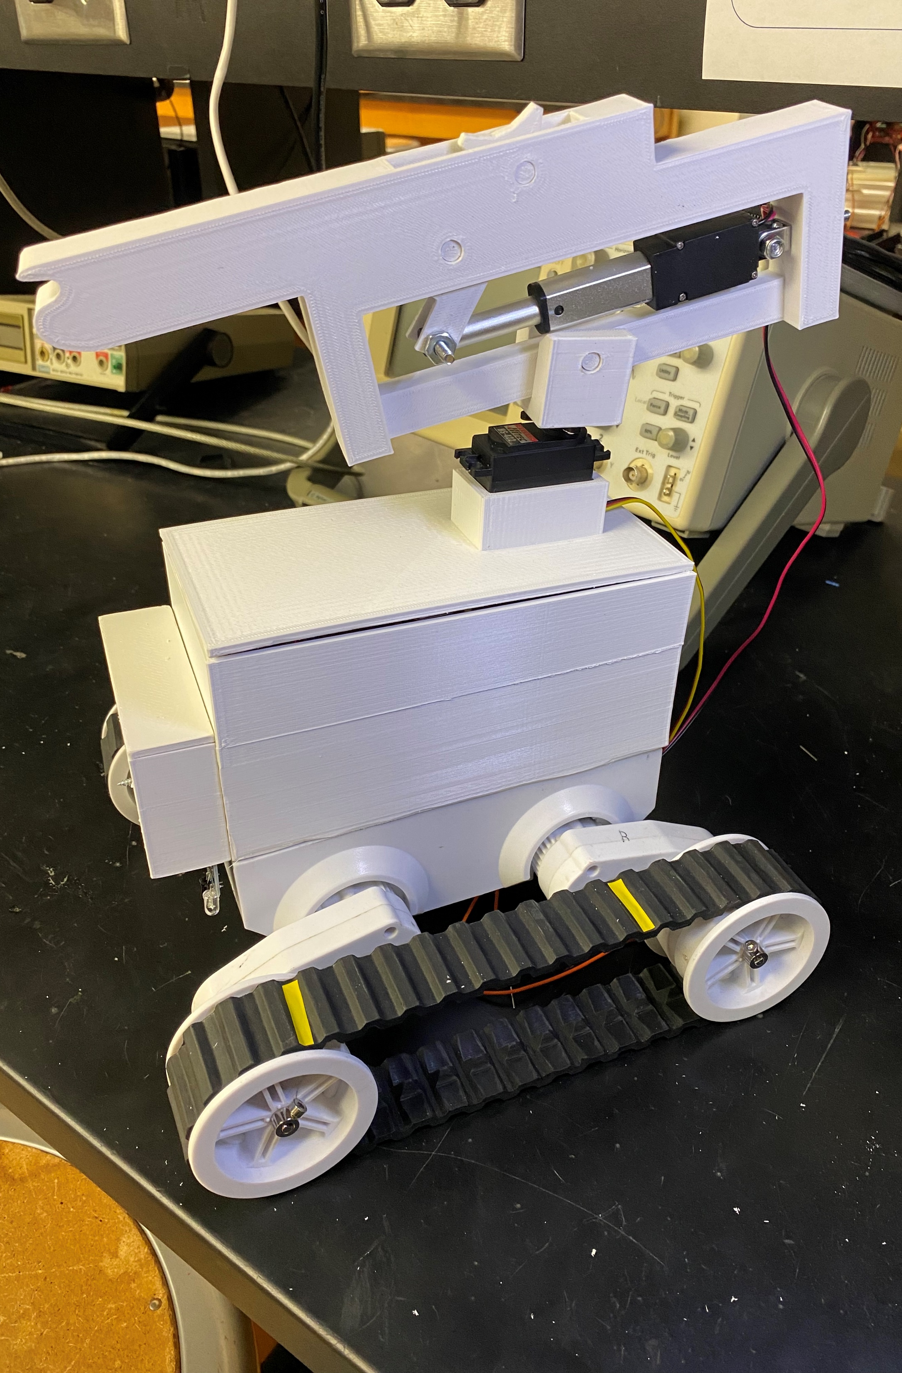
The Project Description & Objectives
Using a BASYS board, H bridge board and sensors to make a rover move along a metallic path and identify friendlies and hostiles along its path while also shooting the enemies by firing rubber bands at them

Slide 3
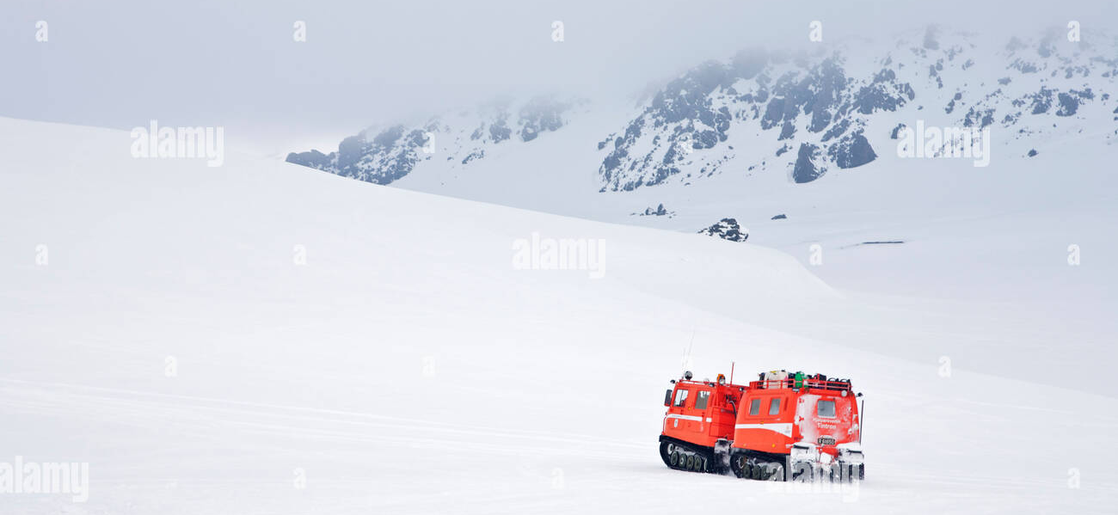
Project Opportunity
Search & Rescue: The rover could be modified to help in search and rescue operations by following a certain path in difficult terrains like snow. It will find people who in danger by making them flash a red light or a flare and detecting that. The gun on top could be replaced with a pointer that points towards the direction of the person in need of help.

Slide 4
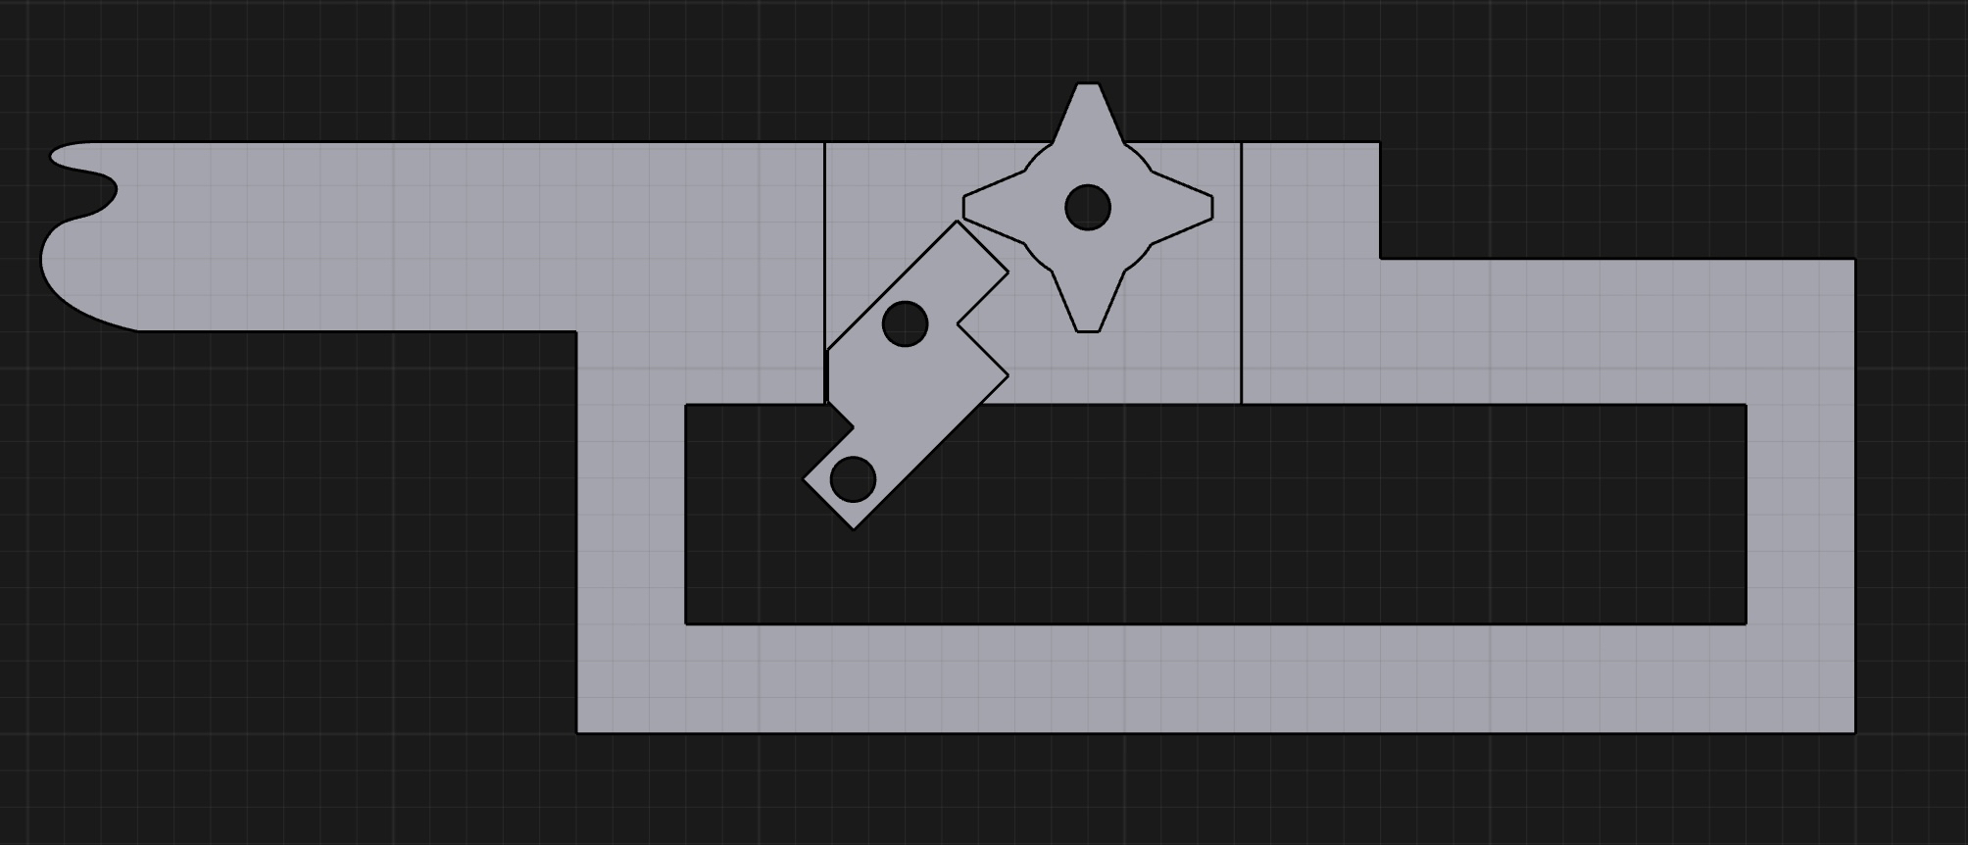
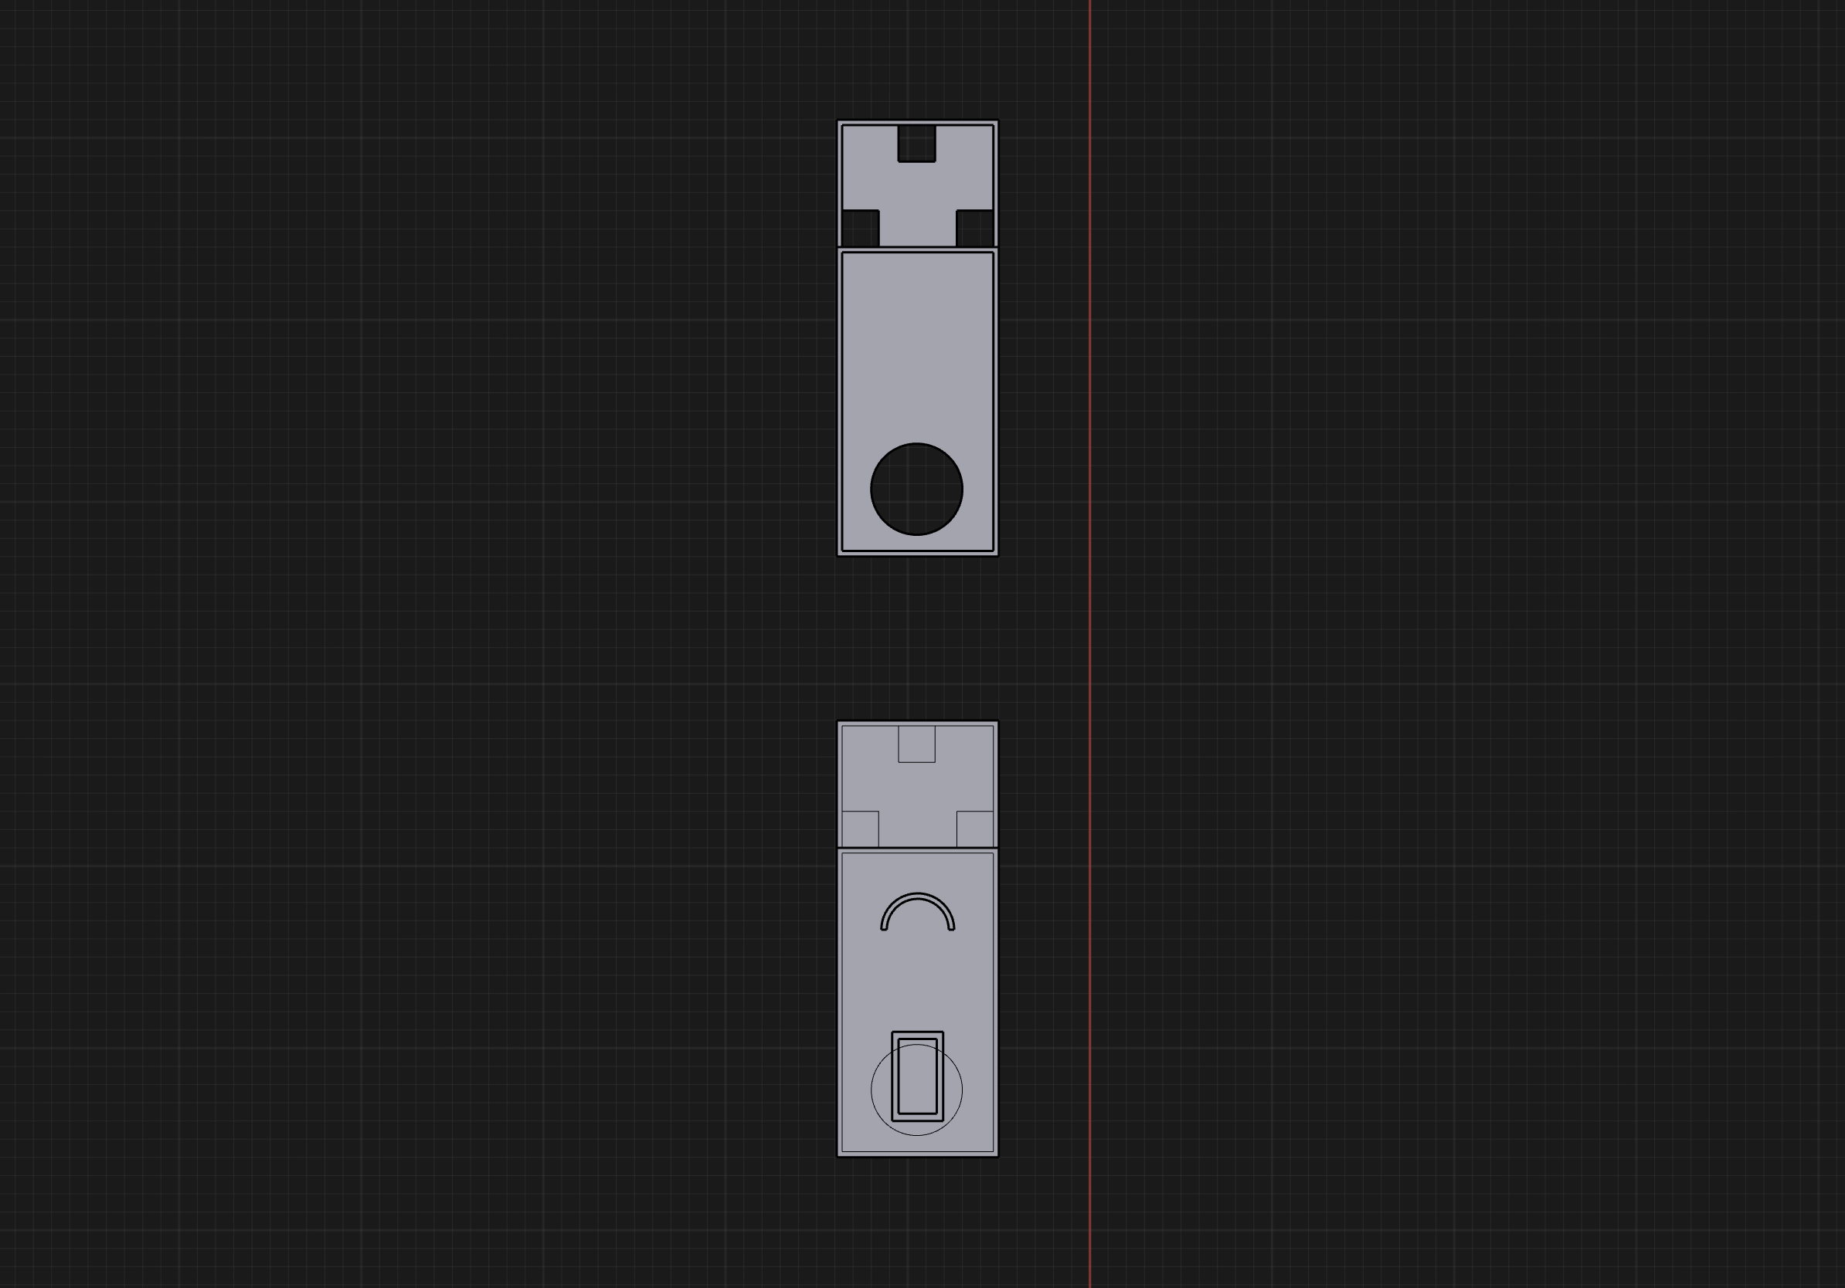
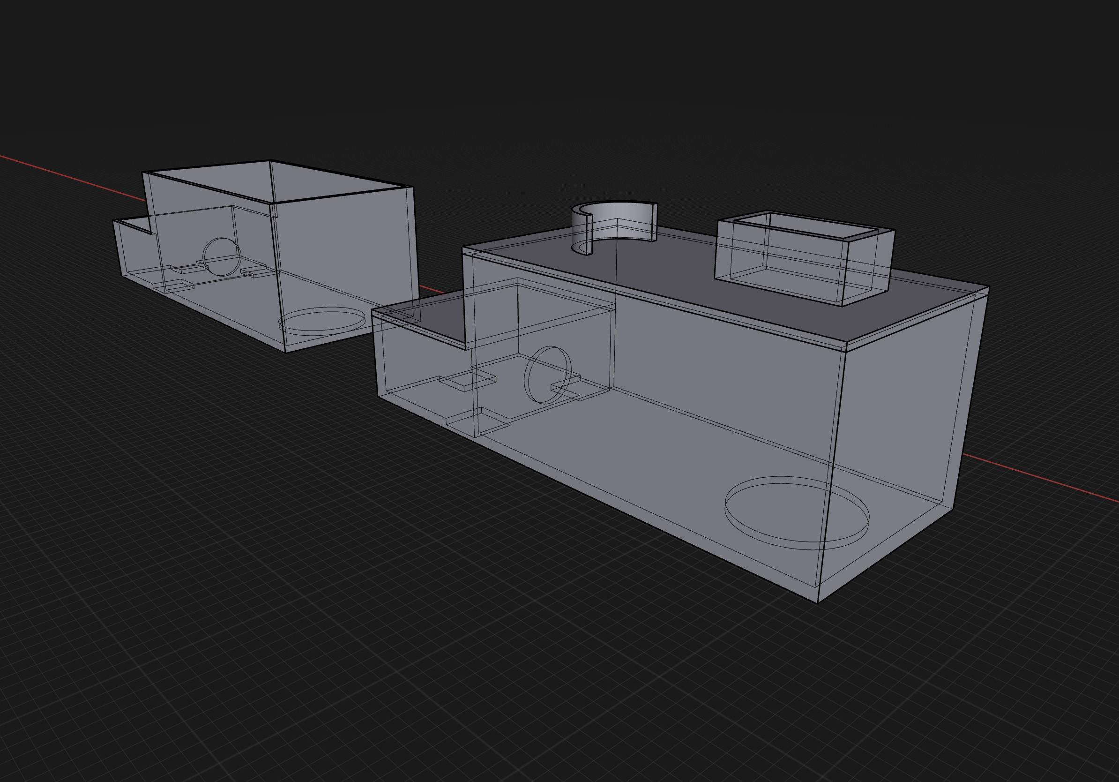
Project Sketch
3D Models for the rover

Slide 5
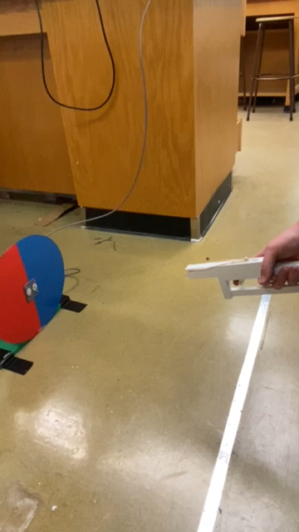
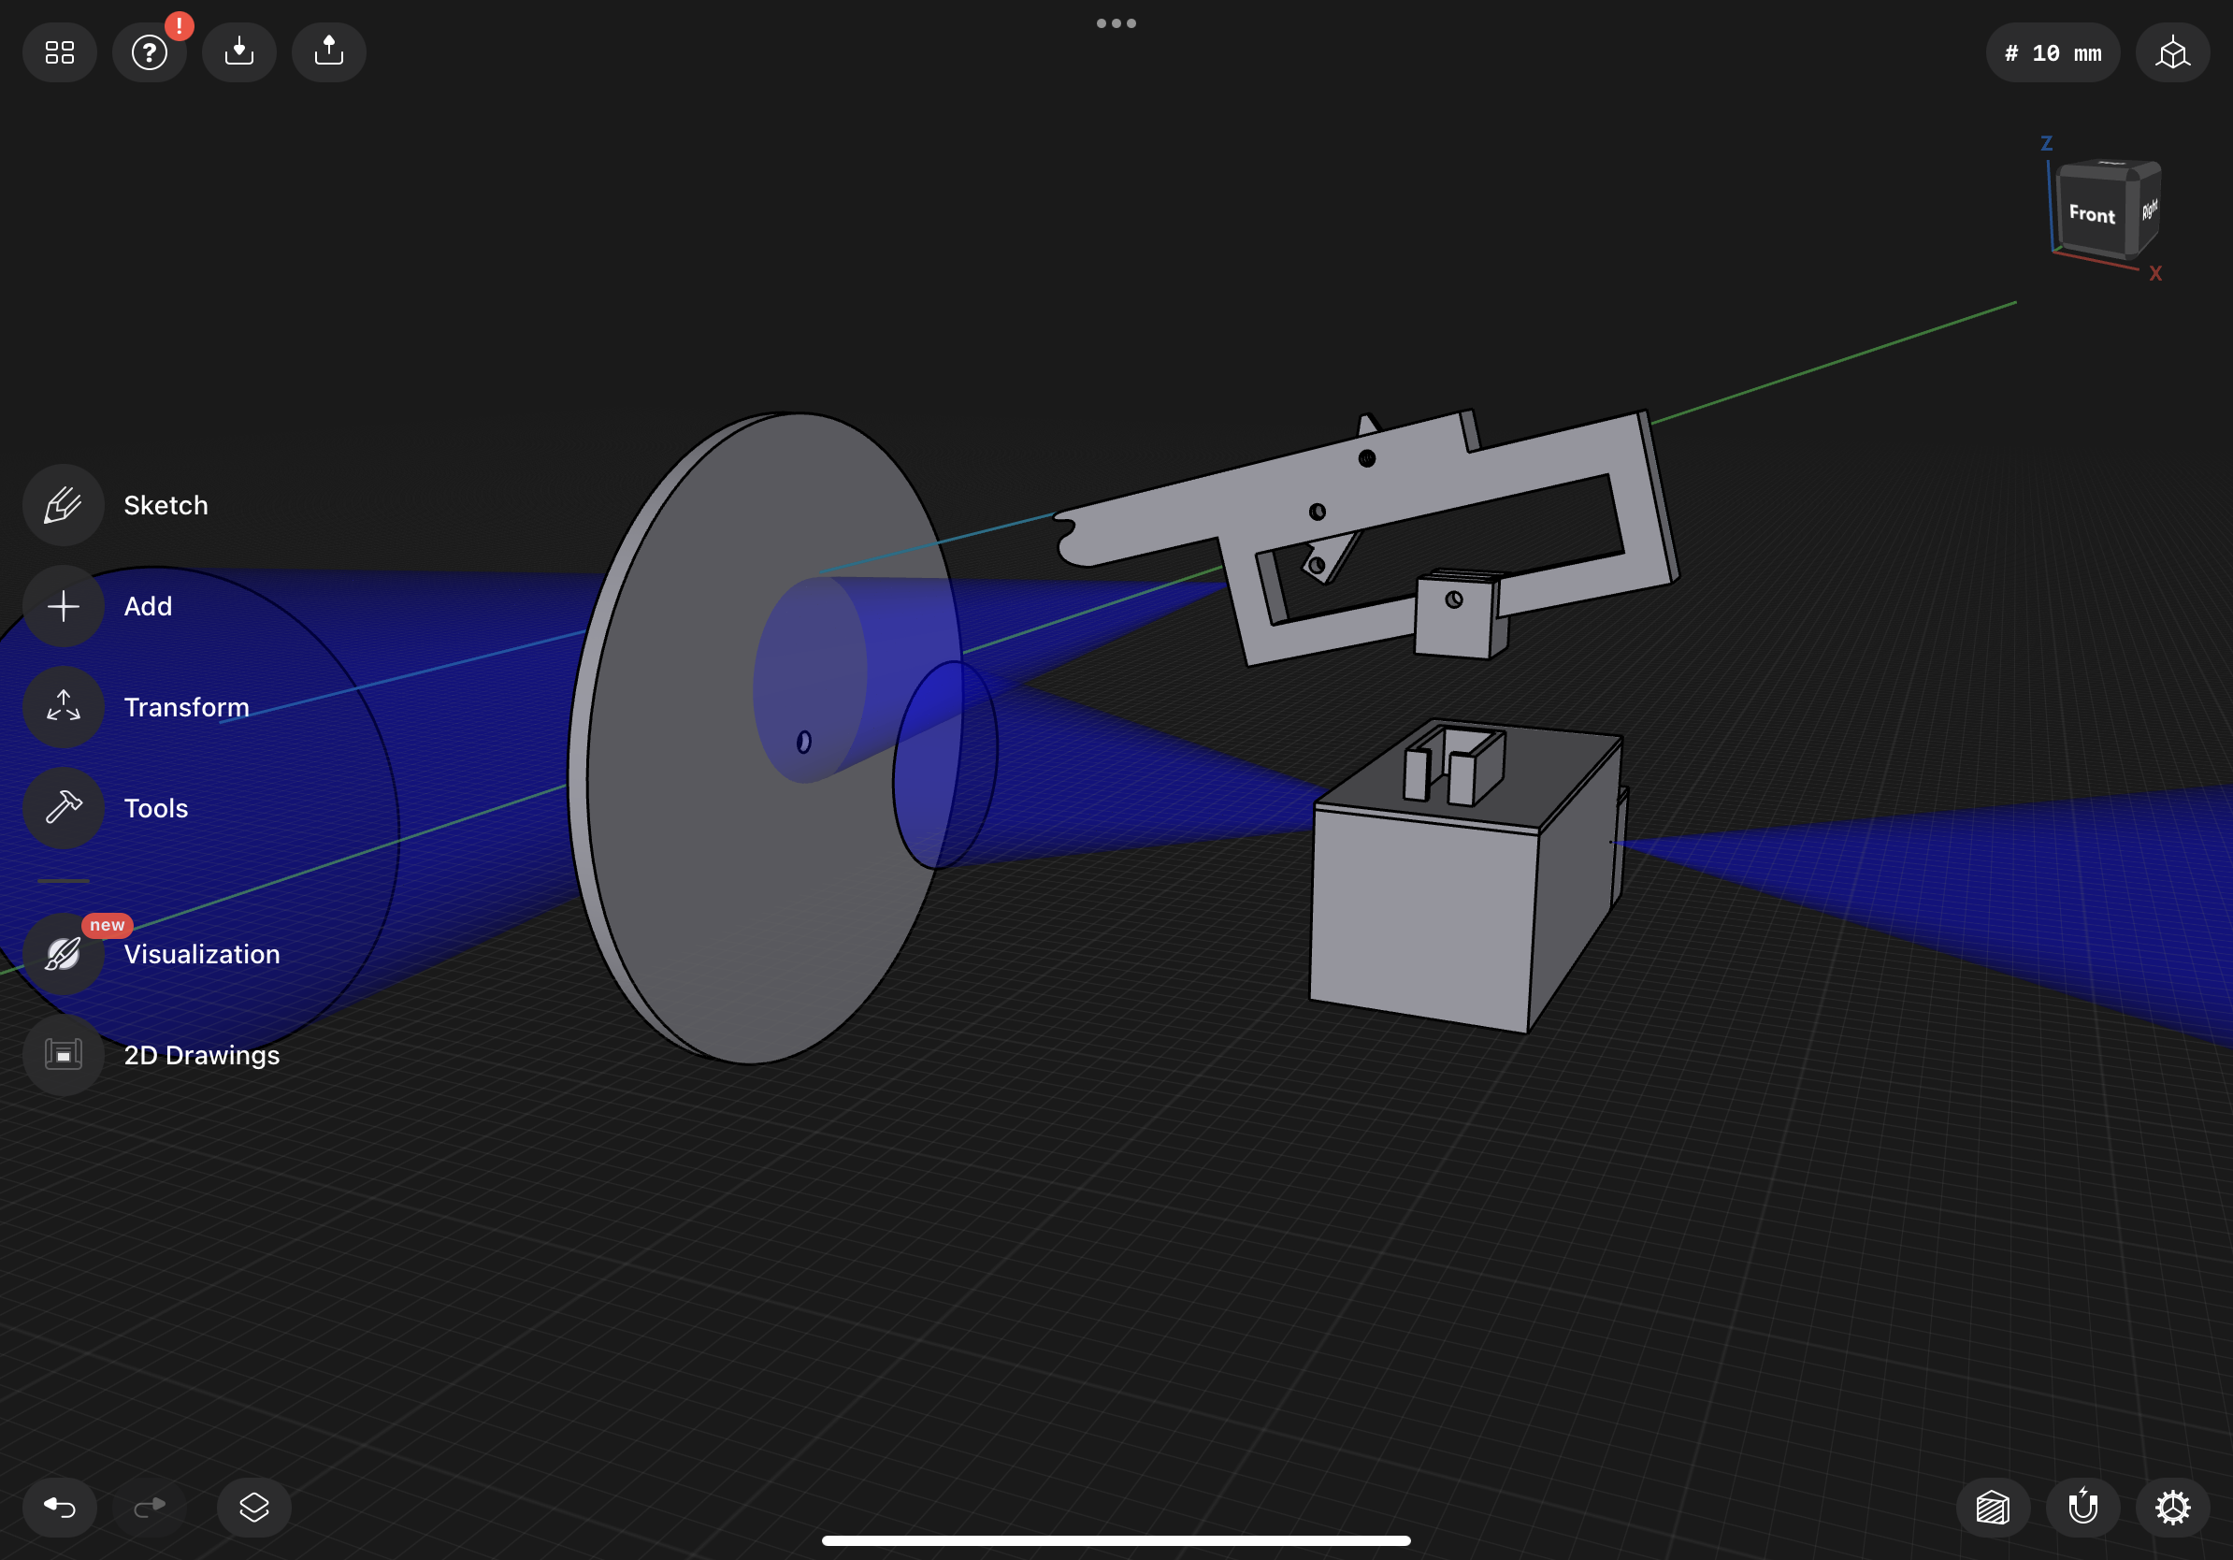
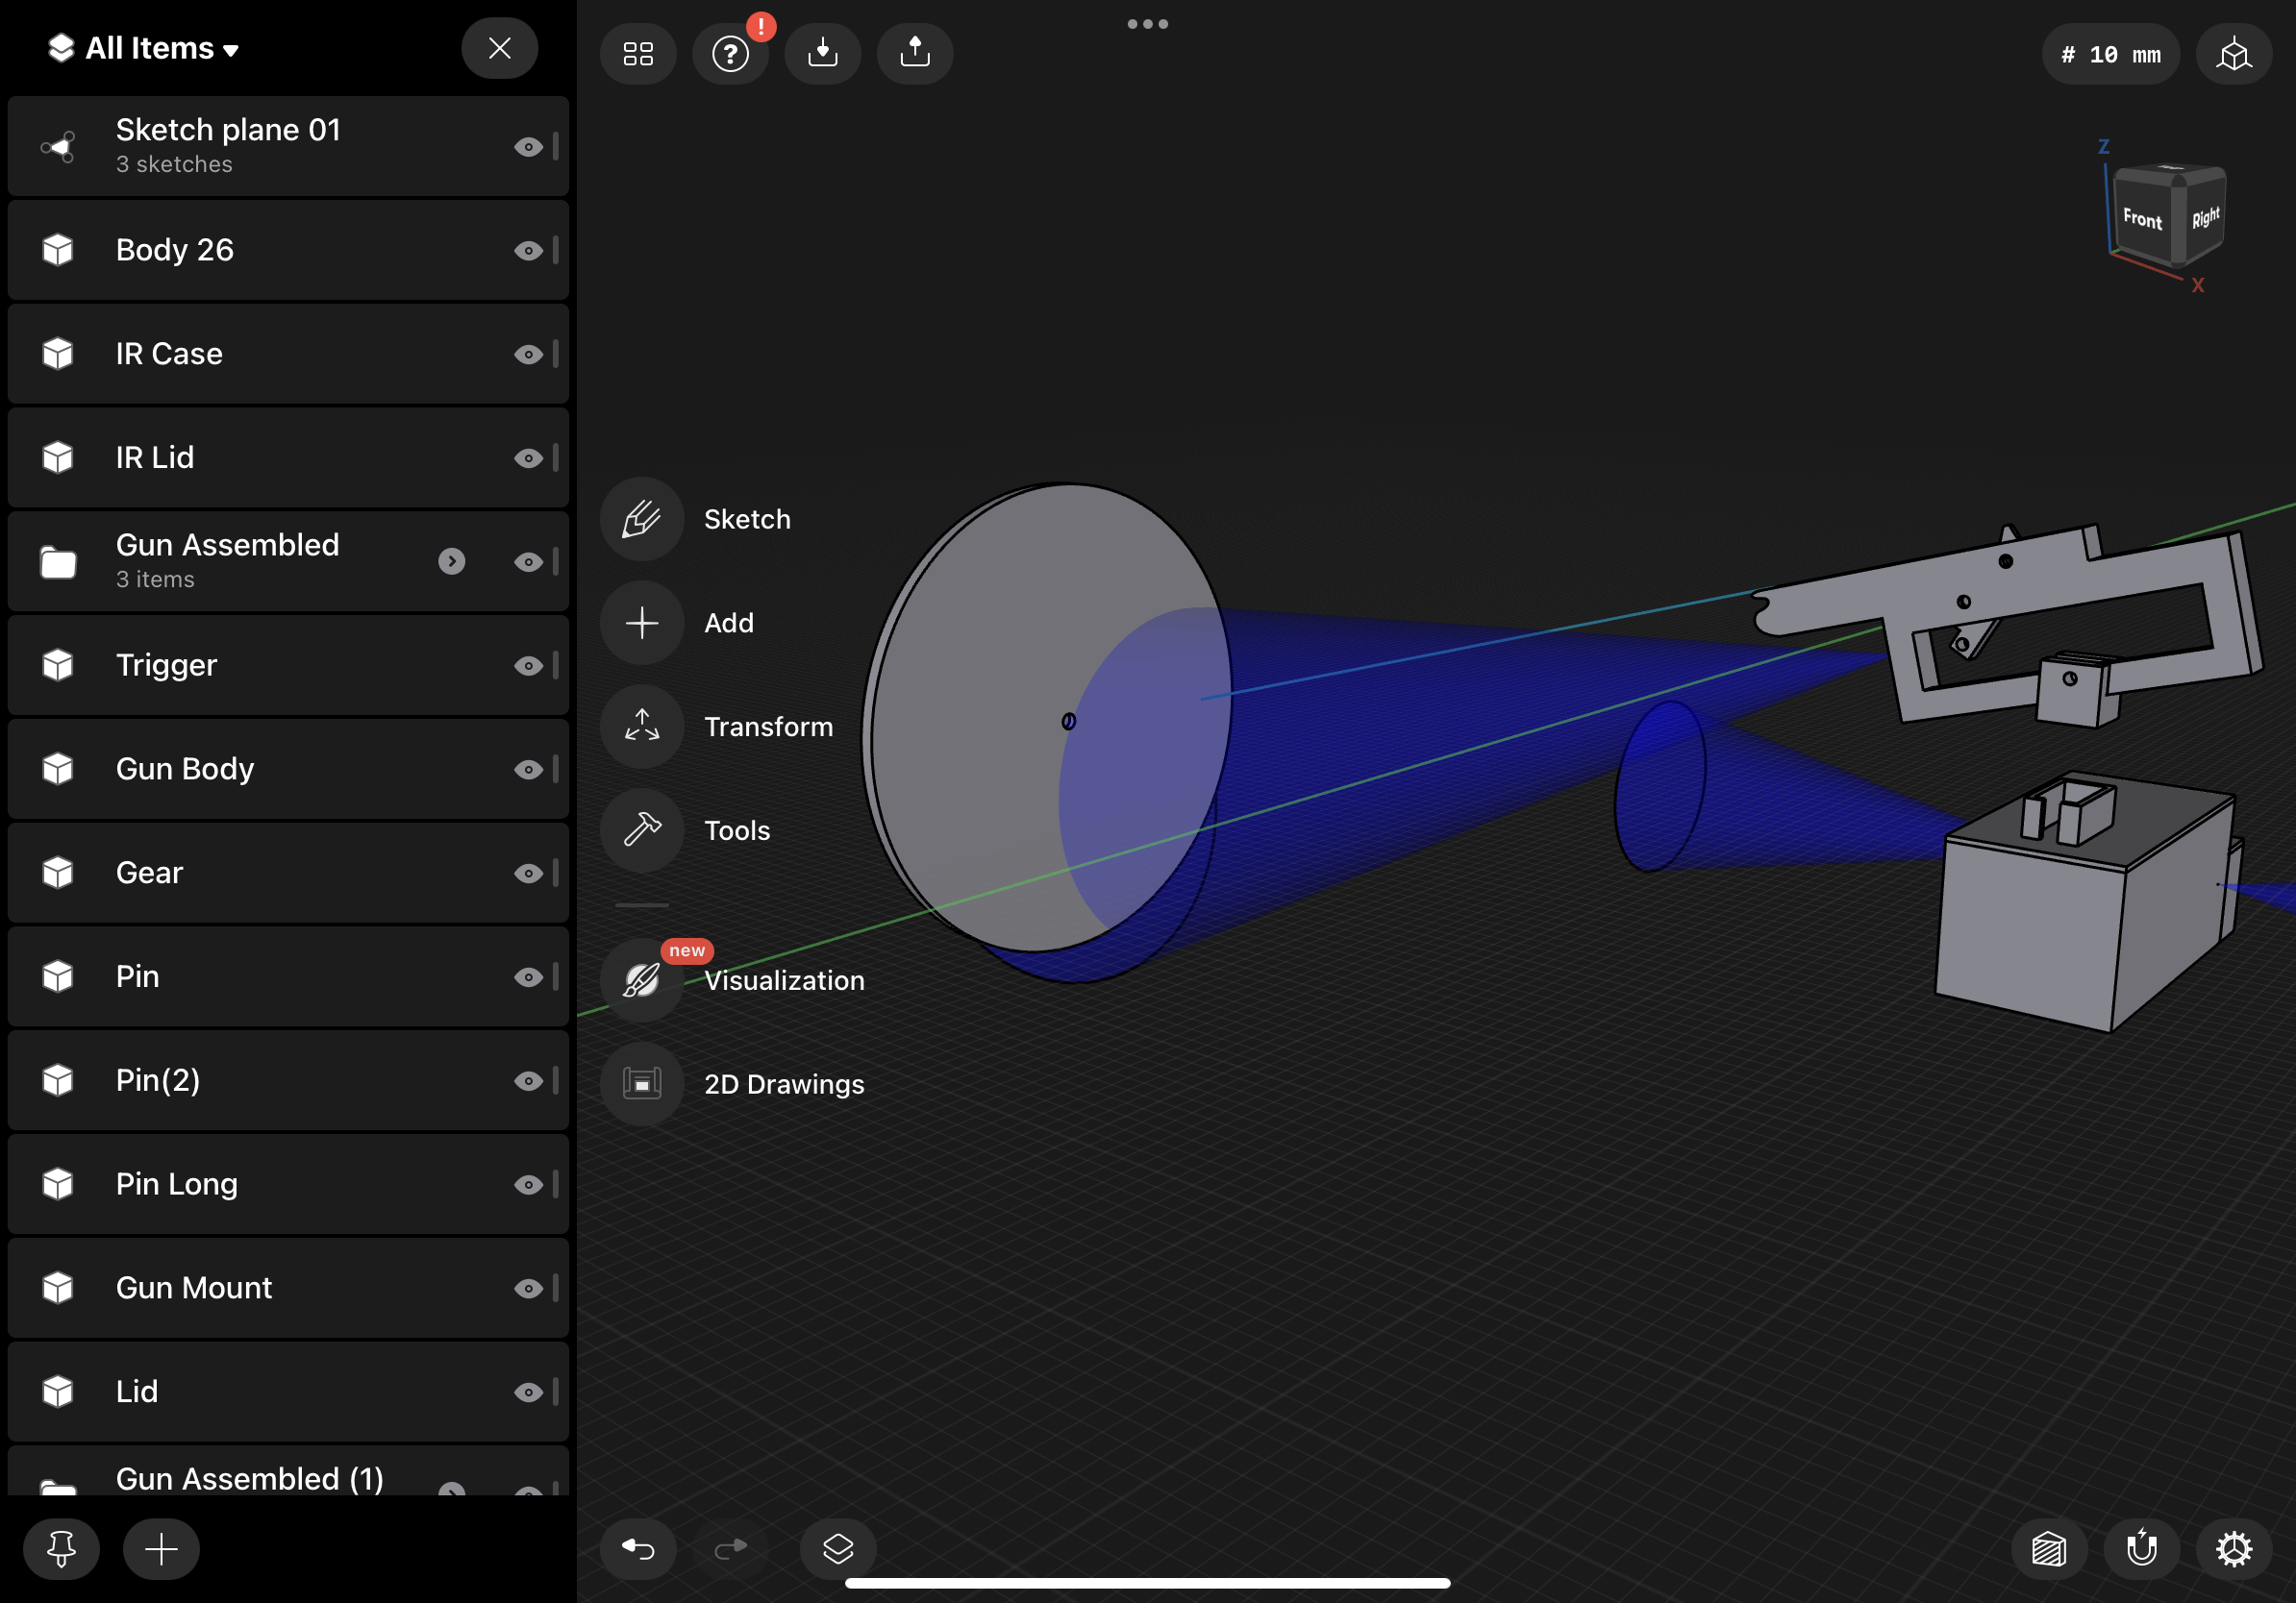
Hardware
Rubber band gun

Slide 6
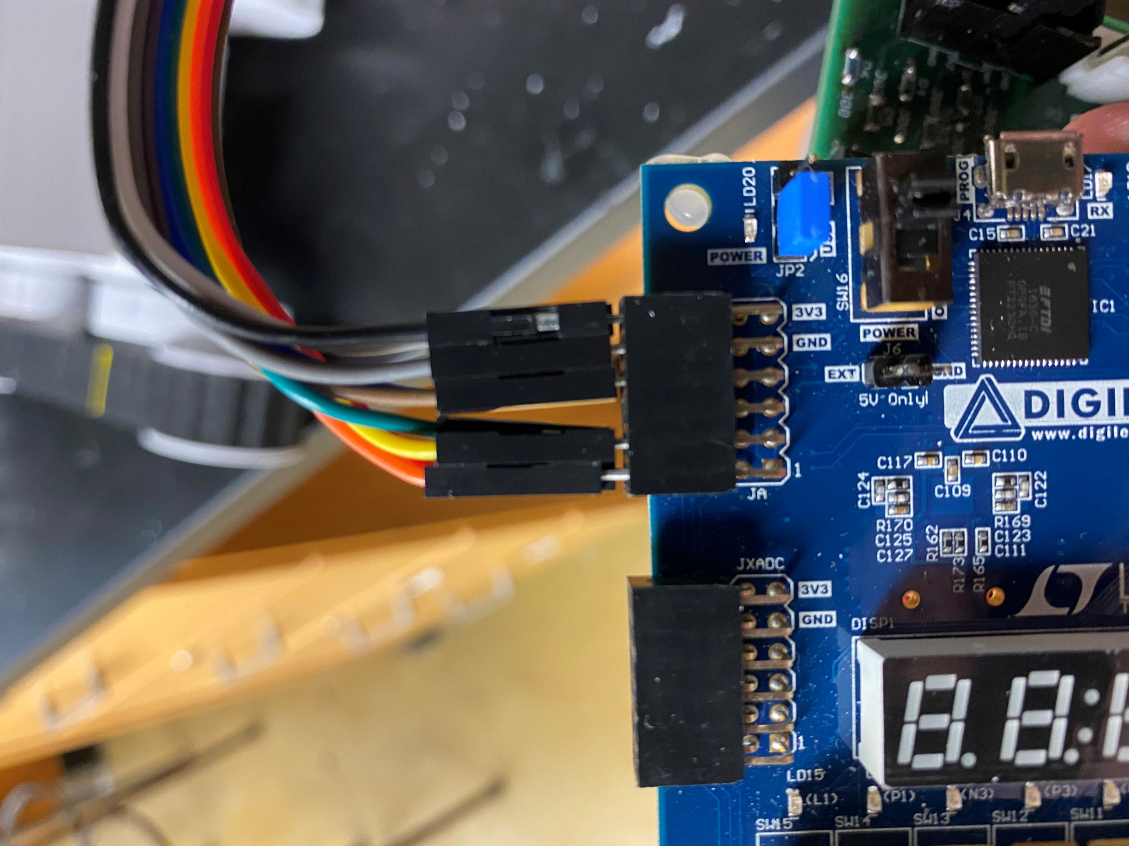
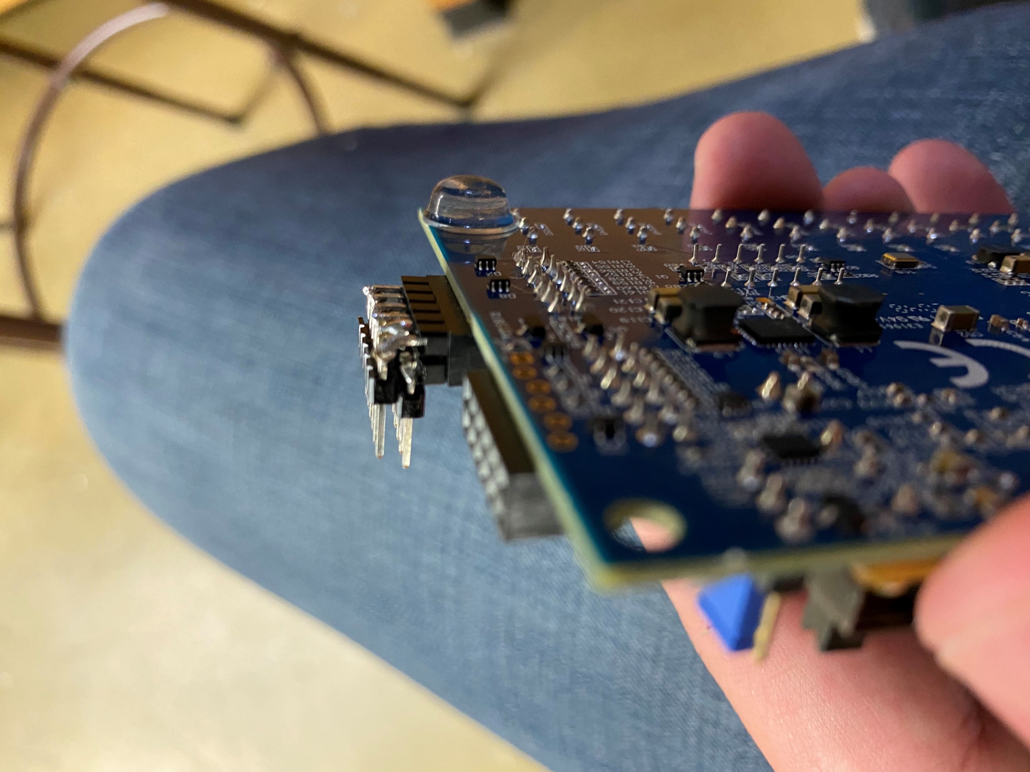
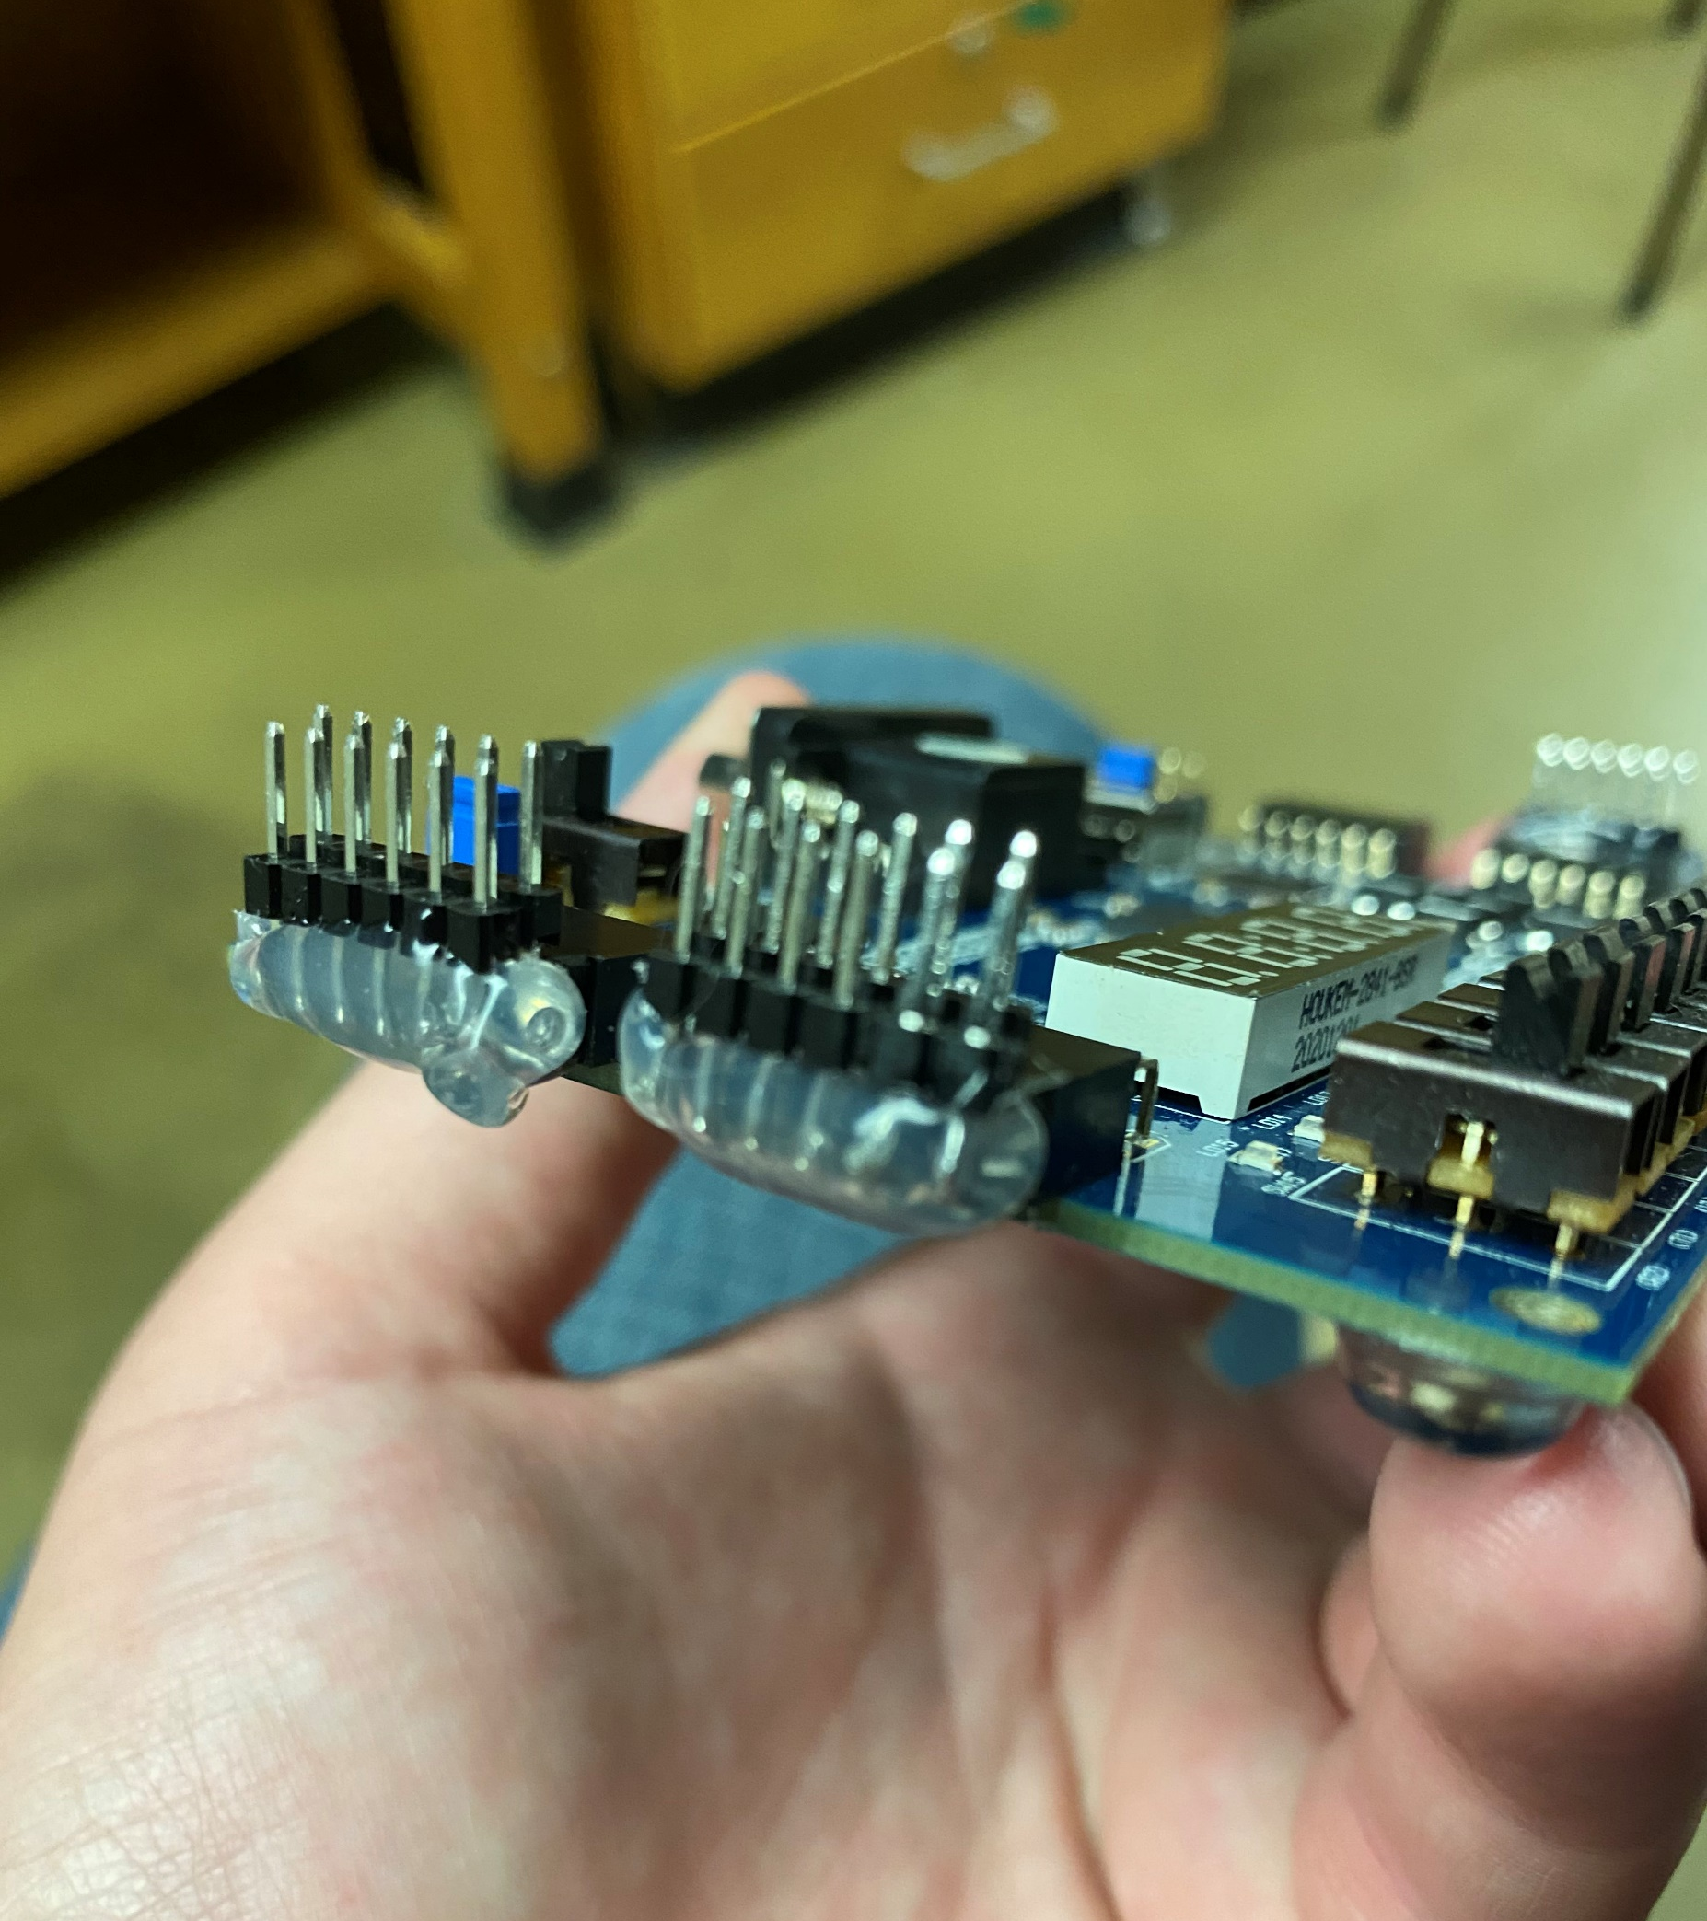
Hardware
BASYS Board update

Slide 7
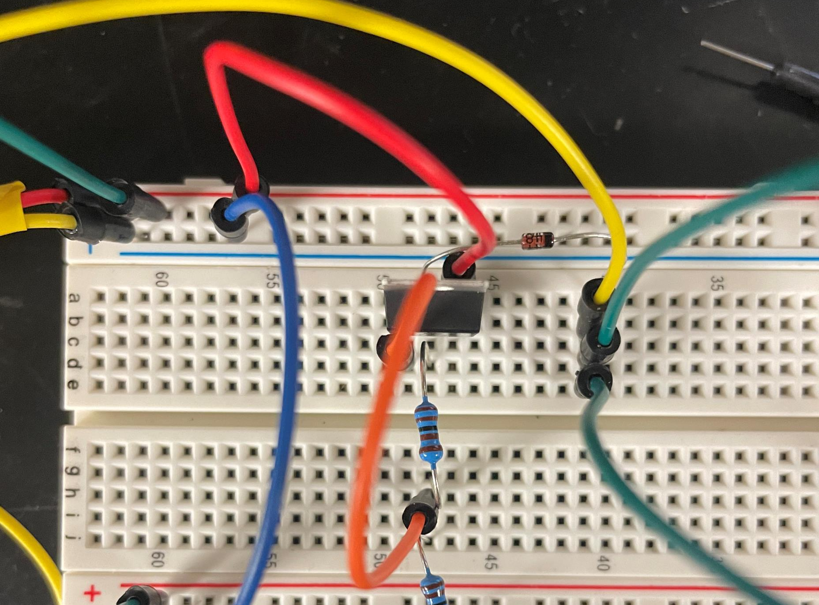
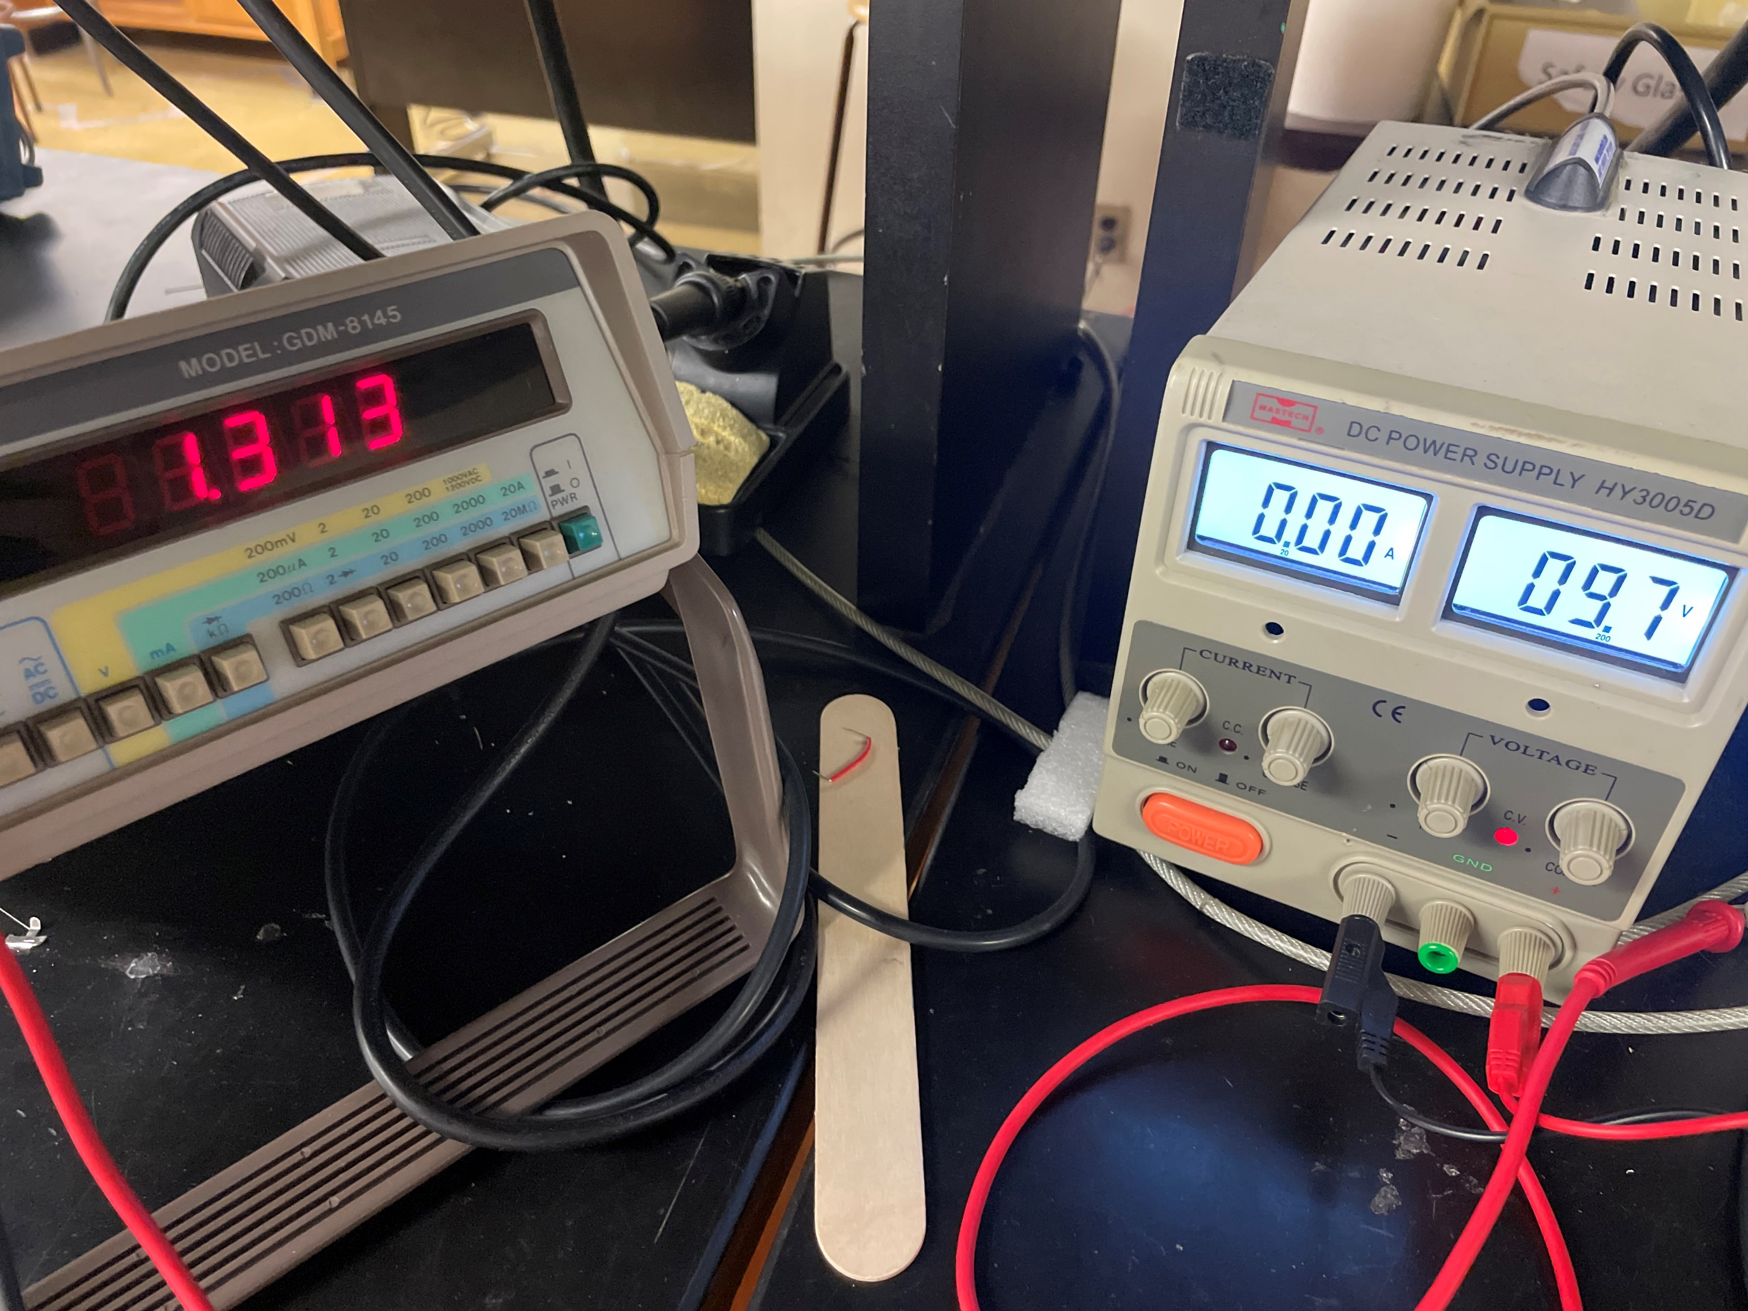
Hardware
1V Regulator

Slide 8
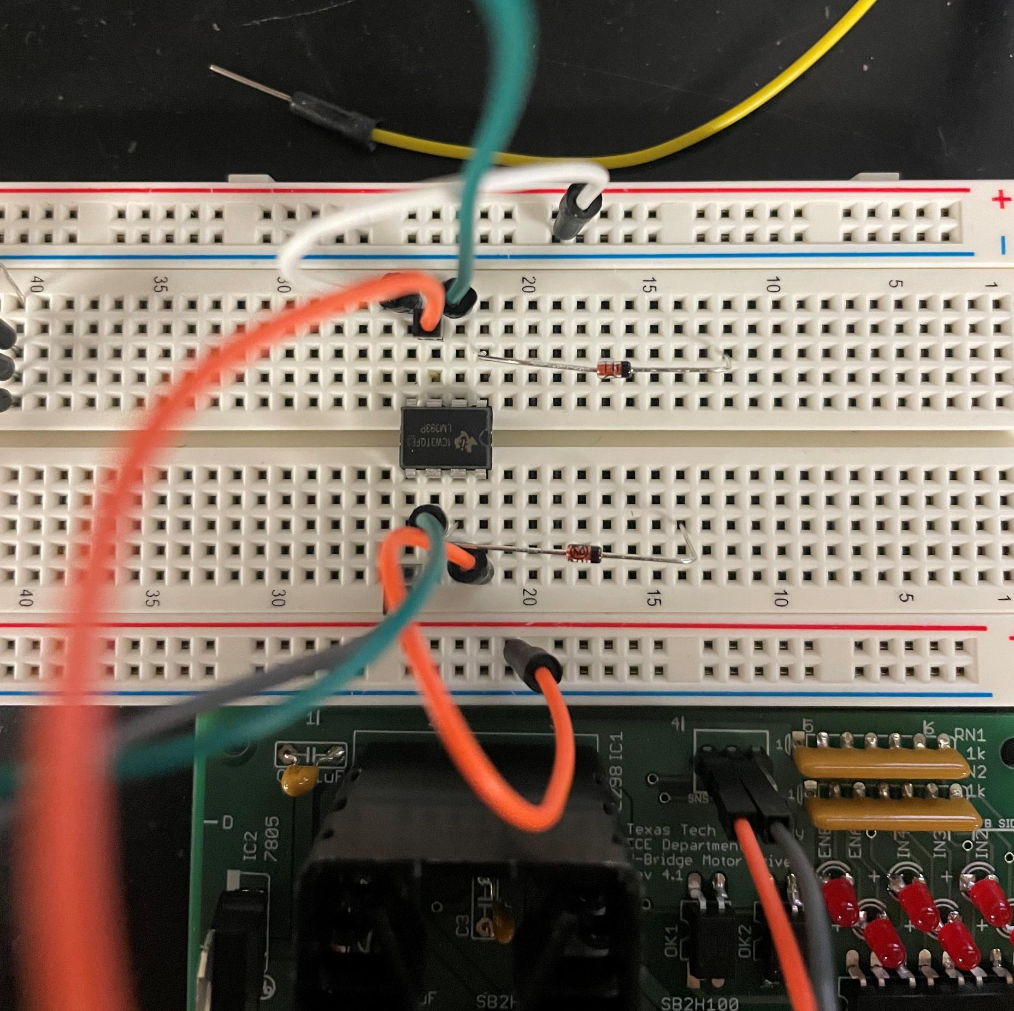
Hardware
Comparator

Slide 9
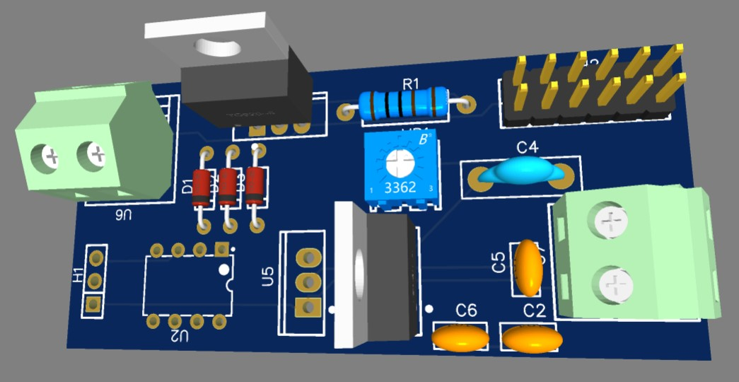
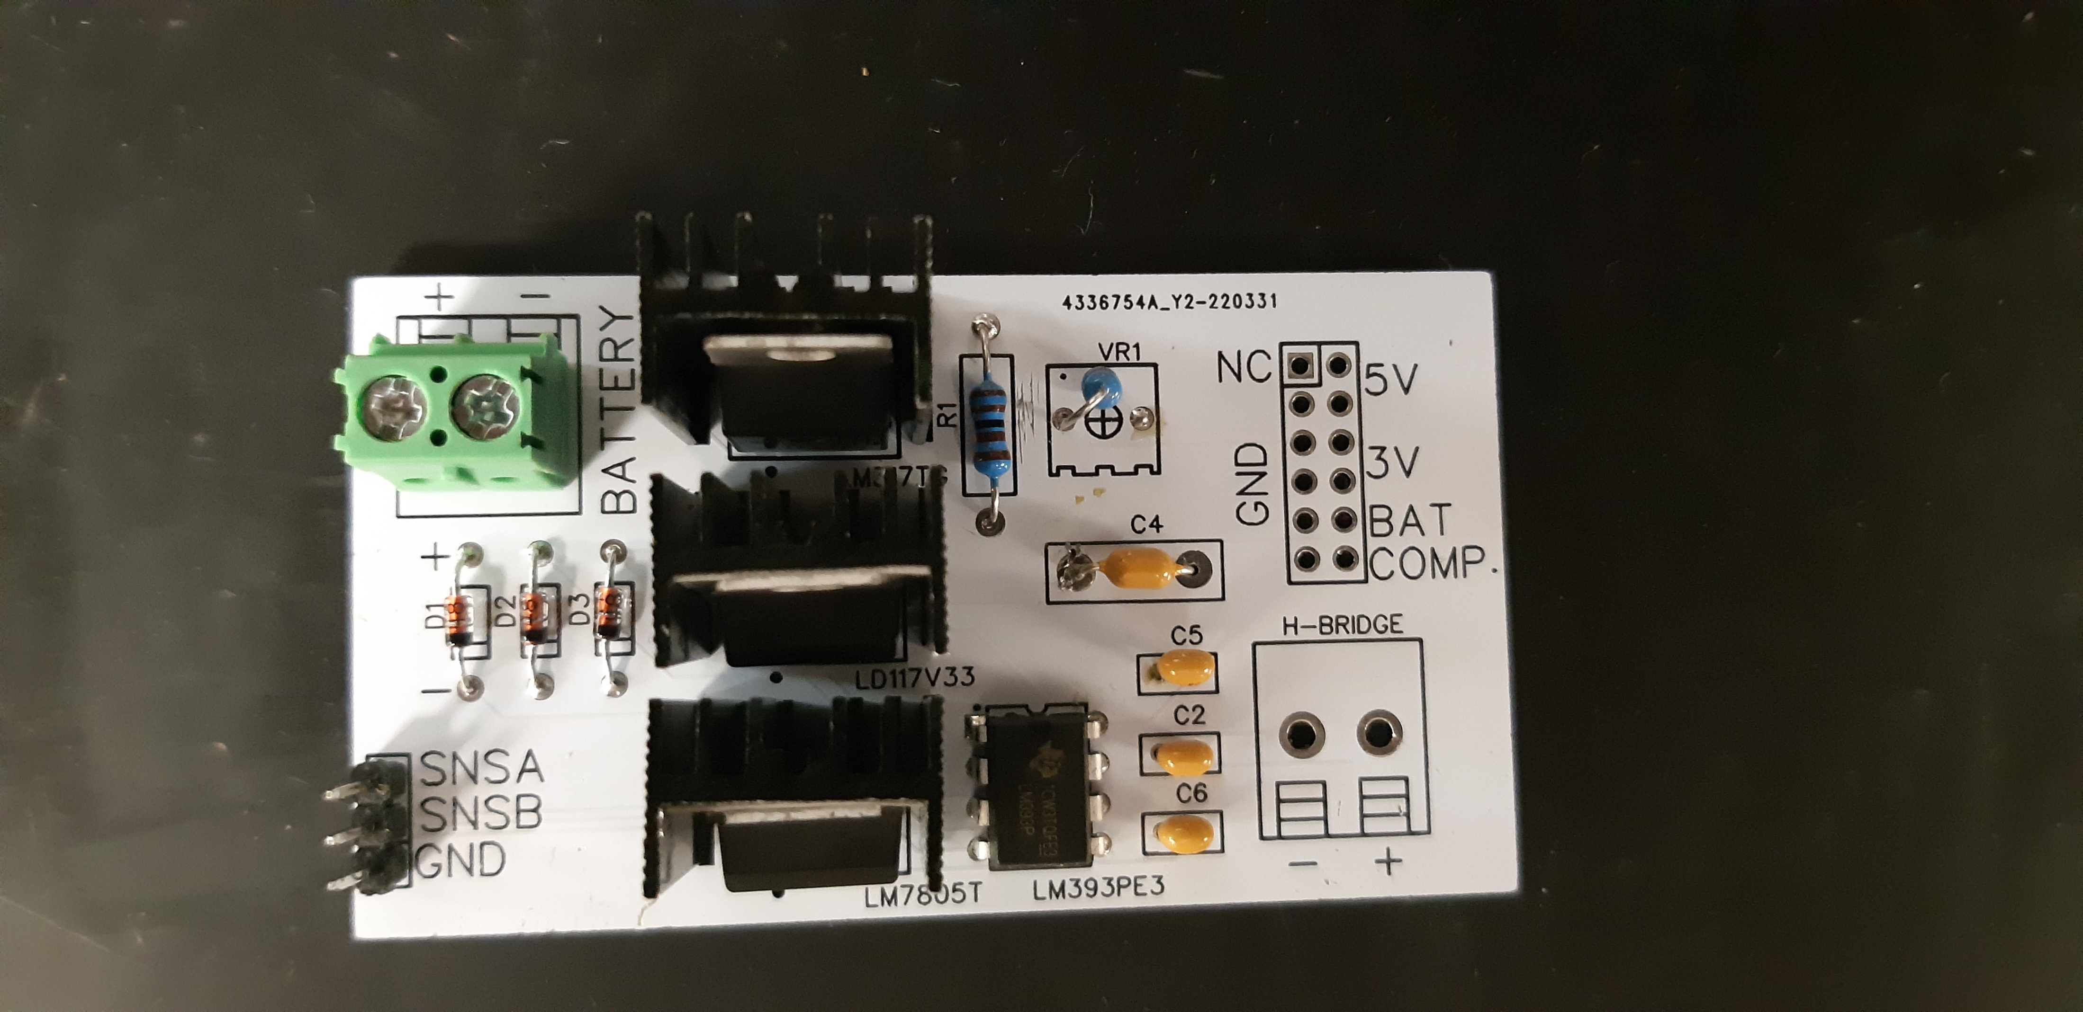
Hardware
PCB

Slide 10
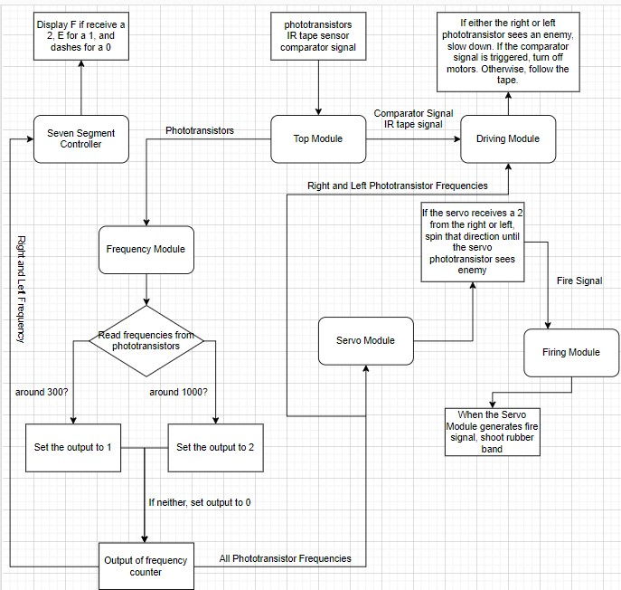
Software
Flow Chart

Slide 11
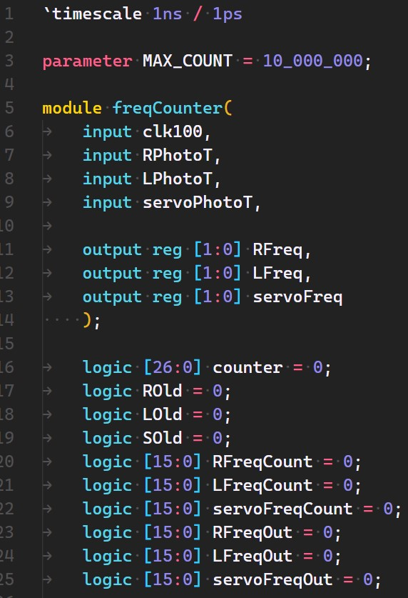
Software
Frequency Counter - Initialization

Slide 12
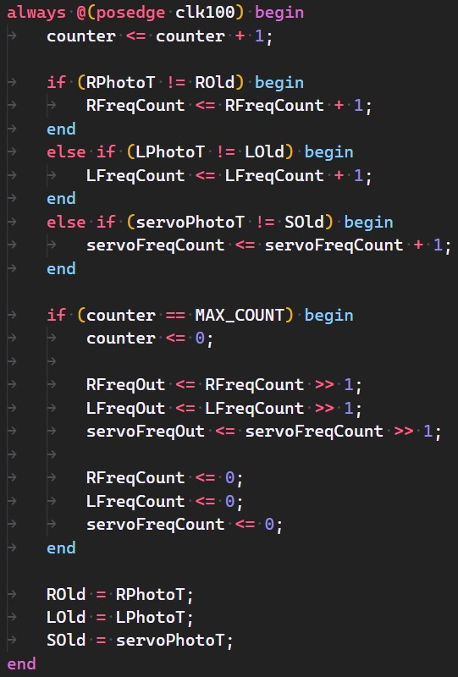
Software
Frequency Counter - Logic

Slide 13
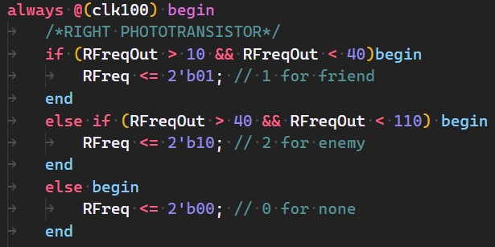
Software
Frequency Counter - Output

Slide 14
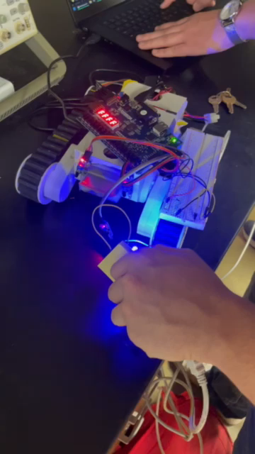
Software
Frequency Tied with Other Modules

Slide 15
Gantt Chart

Slide 16
Overall Budget

Slide 17
Labor Hours and Material costs

Slide 18

Questions
Software Manager: Dirk Thieme
Hardware Manager: Erik Manis
Project Controller: Mohammed Ansari
This Photo by Unknown author is licensed under CC BY.

